Slide 1
EXPLORE KOLHAPUR
Presented By :
1) Kagade Prajwal Arjun - 2210101019
2) Kamble Prashil Prakash - 2210101020
3) Khade Abhishek Bharat - 2210101021
4) Shinde Chetan Sudhir - 2220101052
Under the Guidance Of:
Mrs.P.D.Naslapure

Slide 2
Introduction:
1)Rationally the peoples don’t know the proper information about the destination, how to visit that place, Is there any facilities available or which places are surrounded by the destination they must know but they don’t get the proper source to get information.
2)To overcome these problems, we have created the website “EXPLORE KOLHAPUR”. By using our website, they will get proper guide and proper information about the destination or places.
3)Our mini-project holds significance in providing a dynamic and real content about any place in Maharashtra.
4)Our website will provide user information about the nearby hotels, restaurants, and residentials. With this information website should provide link of website, their contact number, rent of room as per hour and location of that restaurant.

Slide 3
Problem Statement:
In today's fast-paced world, travelers, tourists, and locals alike face the challenge of finding accurate, up-to-date, and reliable information about destinations, places of interest, and services at their fingertips.

Slide 4
Objectives: -
1)To provide proper and real information of user demand place.
2)To develop the dynamic website.
3)To find efficient root for visiting destination.
4)To suggest nearby places.
5)To provide google map.
6)To develop responsive website.
7)To search the places.

Slide 5
Working and Methodology: -
1)Search for Journey Junctions.
2)When you enter the website you can see search bar to find your favourite place.
3)After search, you can see the image of that place.
4)Then scroll up to see the history about the place, as well as google map. Why place is famous for, nearby spots, hotels, residency to visit.
5)After that you see facilities available on that place and their fees. e.g. rope way, scuba diving etc.

Slide 6
Flow chart
Search on browser
Opens the interface of Journey juction
Search the destionation in search bar
About Us page
Contact Us page
Services
Gets the information about destination
Images
History and info of places
Google Map
Nearby places and restuarants

Slide 7
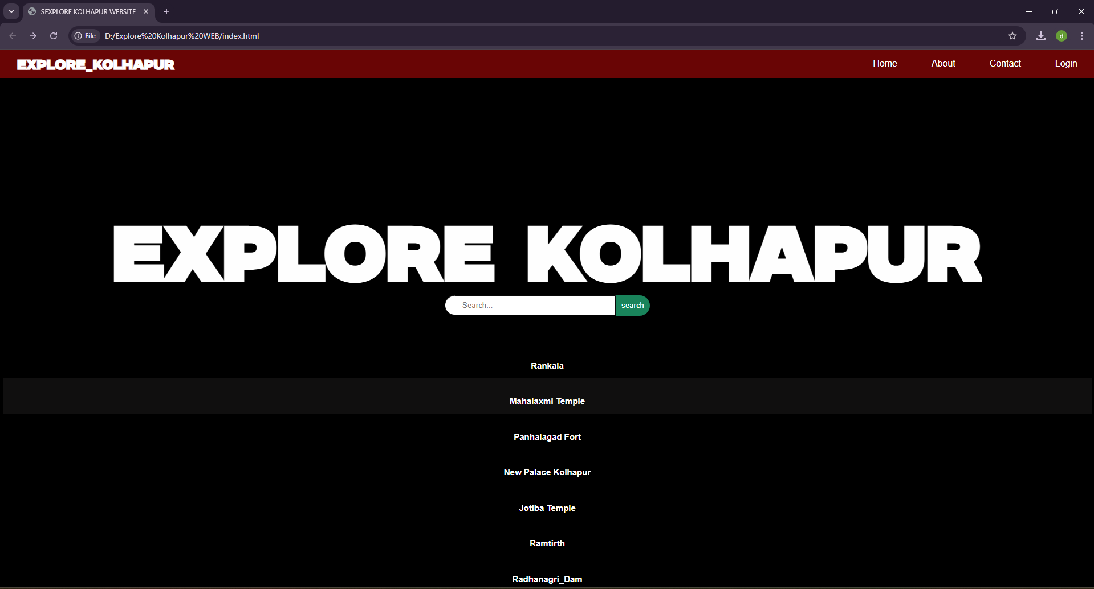
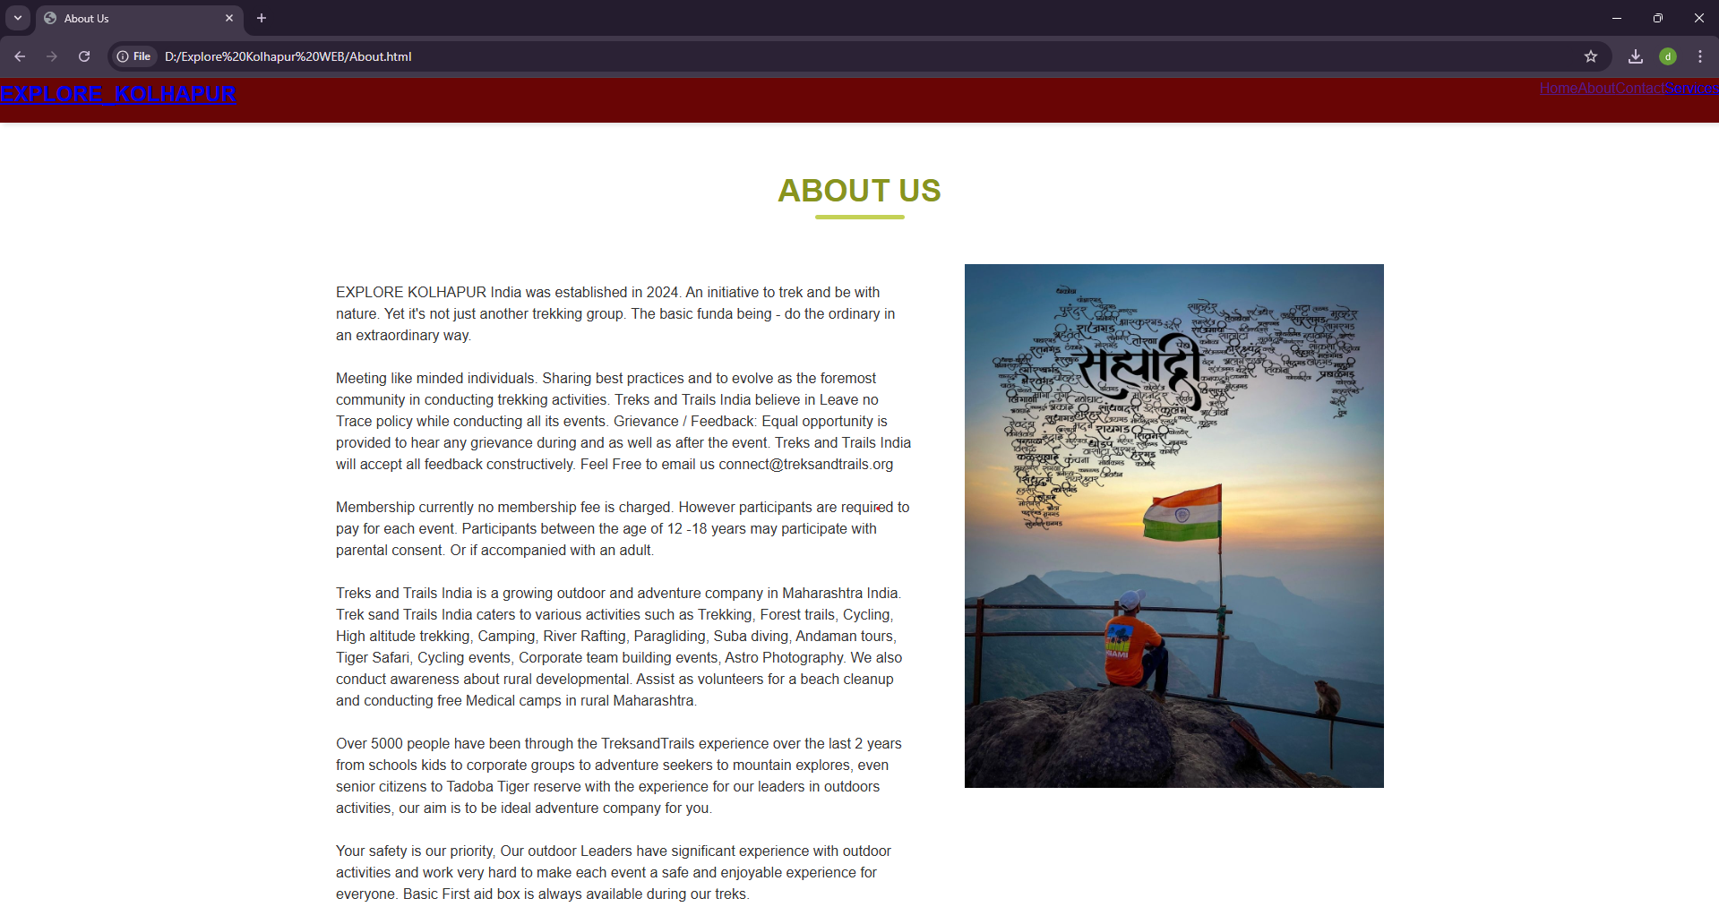
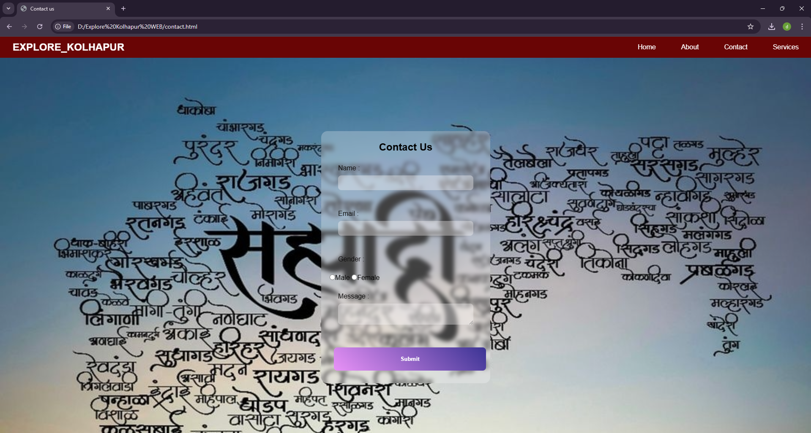
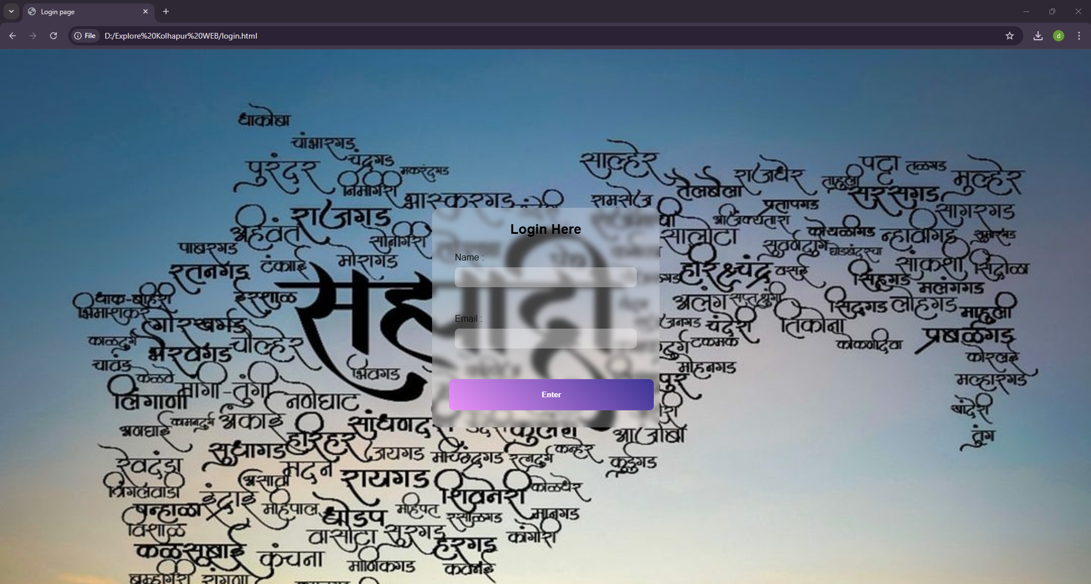

Slide 8
Advantages: -
1)In the website, user can get accurate information about places.
2)User can find nearby hotels and residency at a single website.
3)User can get or know facilities available at the place and their actual cost of facility.
4)User also get actual location of google map at this website.
5)This website is user-friendly.

Slide 9
System Requirements:
1)Hardware: -
Processor: Intel dual core (32 bit)
RAM: 2GB
Processor Speed: 2GHz
2)Software: -
Windows 11
VS code
Chrome Browser

Slide 10
FEATURES
1)User-Friendly interface that facilitates easy navigation, ensuring a seamless and enjoyable experience for trekkers.
2) Search and Filter Options: Blog websites typically offer robust search and filter functionalities, allowing users to quickly find specific destination or places based on the district.
3)Contact and suggestions: Many websites provide wrong information about any places and they never update it, but we have provided contact us page where user can report the wrong content and share their valuable thoughts.
4)User can get actual location on google map and find the shortest path.
5)User can access the website in any device mobile, laptop, tab etc.

Slide 11
FUTURE SCOPE
The future vision for the Explore Kolhapur website includes enabling users to plan their treks more effectively by offering precise and up-to-date information. Additionally, the platform aims to integrate real-time weather updates for specific destinations. A mobile app is also in development, which will feature offline maps, emergency contact details, and trail information to enhance the trekking experience.

Slide 12
CONCLUSION
Explore Kolhapur is a comprehensive solution for travellers seeking reliable information and guidance for exploring destinations in Kolhapur. By offering personalized recommendations, detailed information about accommodations, amenities, and transportation, and a user-friendly interface, we empower travellers to plan their trips with confidence and ease. Our commitment to providing accurate and accessible information ensures that travellers can embark on unforgettable adventures throughout Maharashtra.

Slide 13
REFERENCES
1)Encyclopedias: These books provide a comprehensive overview of various topics, including places.
2) Travel guides: Travel guides, such as Lonely Planet or Frommer’s, provide information about popular tourist destinations and can be a great resource for planning a trip.
3) almostfearless.com: Provides the experience of visiting the places.
4) www.kolhapuronline.in: Provides photos and information of the places.

